Slide 1
PART – II
THE REPEATABLE PROCESS

Slide 2
The Repeatable Process
Once the organization has conducted an assessment, it is then in a position to address its key improvement priorities.
The software process is complex and involves a host of different activities.
The four topics addressed in this part are not the only important issues but they likely represent the highest-priority areas for organizational improvement.
Many other areas need to be addressed, but it is essential to establish priorities.
The major issues in this part are
Commitments
Planning
Configuration Management
Quality Assurance

Slide 3
Managing Software Organizations
The role of management system is to ensure that projects are successfully completed. It requires a continuing management focus on the progress of each project.
Project management starts with a definition of the job to be done and the plan to do it. This involves managing commitments, project oversight and contention.
The basic principles of project management are:
Each project has a plan that is based on a hierarchy of commitments.
Management system resolves the natural conflicts between the projects and between the line and staff organizations.
An oversight and review system audits and tracks progress against the plans.

Slide 4
Making a Commitment
A commitment is an agreement by one person to do something for another.
This involves a planned completion date and some consideration or payment.
Commitment is described as a way to sustain action in the face of difficulties.
Commitment is essential foundation for large scale work. When the coordinated efforts of many professionals are involved, mutual commitments are essentials.

Slide 5
Making a Commitment
When two programmers cooperate on a single project, they must divide up the work.
This division starts with agreement on the distribution of functions, common interfaces, standard formats and naming conventions.
As work progresses, test plans are needed, and each may require design data from the other, as well as preliminary versions.
For either programmer to perform effectively, each must know what the other is doing and be able to rely on its being done as agreed. This is achieved through a commitment process.

Slide 6
The elements of an effective commitment are
The person making the commitment does so willingly.
The commitment is not made lightly, the work is involved, the resources, and the schedule are carefully considered.
There is an agreement between the parties on what is to be done, by whom, and when.
The commitment is openly and publicly stated.
The person responsible tries to meet the commitment, even if help is needed.
Prior to the committed date, if it is clear that it cannot be met, advance notice is given and a new commitment is negotiated.

Slide 7
The Commitment Hierarchy
While the commitments are met by committed individuals, the work is not done in vacuum.
The professions need to feel they are part of the organization that treats its commitments seriously, they will strive to do their part.
This makes the management team to take care in making commitments and insists on efforts to meet them.
A commitment is visible. An action that impresses the software professionals is strong management support in negotiating requirements changes with the customer.
With this backing, they are able to develop and meet their plans and estimates.

Slide 8
The Software Commitment Process
To be effective, the software commitment process must reach to the top of the organization. This requires
All commitments for future software delivery are personally made by the organization’s senior executive
These commitments are made only after successful completion of a formal review and concurrence process
An enforcement mechanism ensures that these reviews and concurrences are properly conducted
The senior executive’s personal involvement is what motivates the entire commitment process.
The people know they must justify their recommendations in a visible process and that poor work will likely be exposed.

Slide 9
The senior management should require evidence that the following work was done prior to approving a commitment
The work has been defined and agreed between the developers and their customers.
A documented project plan has been produced, including a resource estimate, a schedule and a cost estimate.
All directly involved parties have agreed to this plan in writing.
Adequate business and technical preparation has been done to ensure that the commitment represents a reasonable risk.
An independent review has been conducted to ensure that this planning work was done according the organization’s standards and procedures.
The groups participating in the work have or can acquire the resources required.

Slide 10
Establishing a Commitment Process
A commitment can be established quickly.
The basic requirement is a senior executive who is willing to insist the required planning to be done before any commitment is made.
Since people must know how to make schedules and estimates, training courses are required, specific estimating, review, and approval procedures.
Once the senior manager decides to implement a commitment process, these items can be readily accomplished.

Slide 11
The Management System
Management’s goals and objectives are like fuel that drive the engine, and the commitment process is like lubrication. The management system is the gear that distributes the power, sets the pace, and points to the organization’s direction.
Every organization will have unique objectives, and there generally four components
To have a technical and business strategy that aims at long-term goals as growth rate or market position
To provide quality products that meet customer’s needs in a timely and effective way
To perform the assigned mission competitively and economically
To improve continually the organization’s ability to handle more challenging work

Slide 12
Product and Period Plans
To resolve the conflicts and to establish a framework for operations, most organizations produce annual operating plans. These specify the tasks to be performed and assign the responsibilities and resources to accomplish them.
Skilled resources is the most important need of every project and staff, their allocation is the first essential step in producing these plans.
The operating plan deals with technical and business issues in annual and organizational terms. Thus expenses, capital requirements, product delivery commitments are established for each period by each organizational entity.
Similarly, annual productivity and profitability objectives are stated, together with the strategies for achieving them.

Slide 13
Product plans focus on the activities and objectives of each project. The major issues are function, cost, schedule and quality, together with related resources and checkpoints.
Each project has its own management and some dedicated resources, while all projects rely on common resources for some of their work.
They report to senior management on a periodic oversight basis. They are monitored by common staff and audit groups who inform management of the problems and risks of meeting the period and product goals.
Project personnel view their work as the fundamental business of the organization.

Slide 14
The project is not set up as an annual basis and has considerable difficulty in producing annual data on items as cost, quality and productivity.
Organizations are measured and managed on a period basis and project data must be translated into period terms for inclusion into annual budget, plans or stakeholder reports.
Management Oversight
An effective management system uses reviews and contention system to resolve product and period conflicts and establish the balance between line and staff. Each line and staff organization prepares its annual plan and reviews it with all involved parties.
The issues are then resolved, the separate plans are consolidated into a total organizational plan, and this total plan is incorporated in the plan for next higher organizational level.
Each project establishes its own plan prior to project initiation and periodically reviews and updates it.

Slide 15
Contention Process
An effective review system requires a parallel contention system to encourage the open expression of differences and their resolution.
The principle behind contention system is that the best decisions are based on a full understanding of the relevant issues.
There are many ways to solve problems and there is an agreement on the best approach.
Most organizations find contention systems helps them to arrive at better decisions.

Slide 16
The principles of contention system are
All major decisions are reviewed with the involved parties in advance, and the parties are requested to agree. Where possible, any issues are resolved before proceeding.
When the time comes for decision, all parties are present and asked to state their views.
When there is no disagreement, the senior manager determines if there is knowledgeable agreement, if any disagreeing party are absent, or if more preparation is needed.
In the latter two cases, the decision is deferred until necessary work has been done.

Slide 17
Quarterly Review
It provides the forum for resolving conflicts and monitoring progress against period and product objectives.
The topics include an assessment of project against plan and the organization’s performance against its goals.
The site manager is the senior executive over an operation that has three main functions: projects, technical support and finance.
The technical support organization includes
Central computing services for the laboratory
Software Configuration Management (SCM) group
Software Quality Assurance (SQA) organization
Software Engineering Process Group (SEPG).

Slide 18
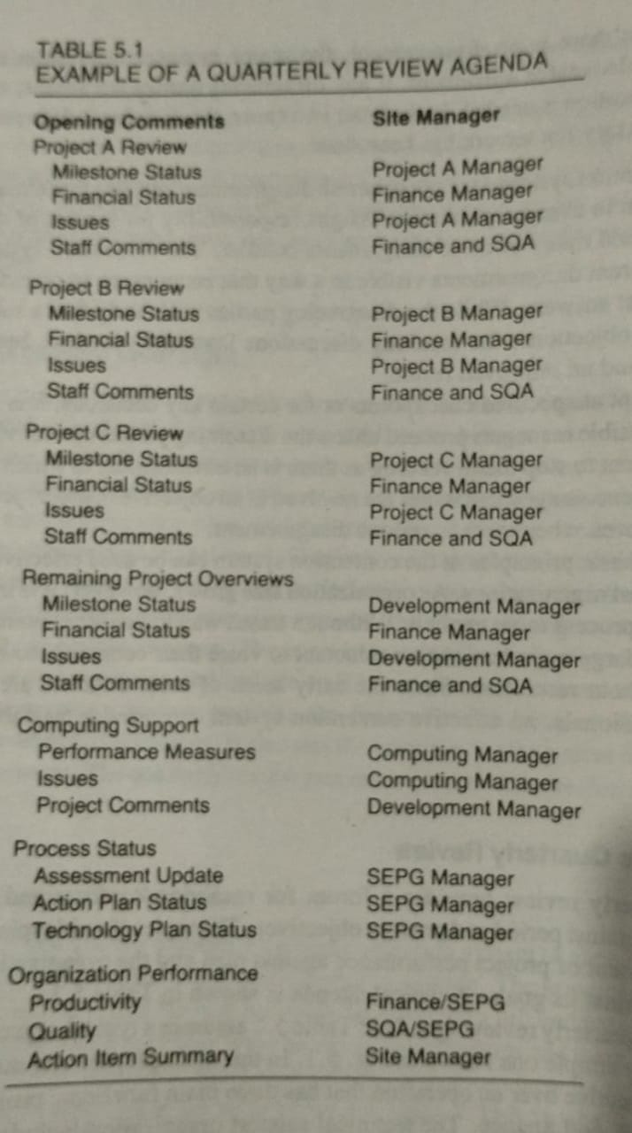

Slide 19
Quarterly Review
The project portion of the quarterly review examines the status of each major project against its plan and objectives.
Each project should thus have an approved plan against which progress is reported.
The key is each project manager must summarize each quarter what is accomplished in the previous quarter and what is planned for the next.
If the work is proceeding as planned, these reports are crisp and in brief.

Slide 20
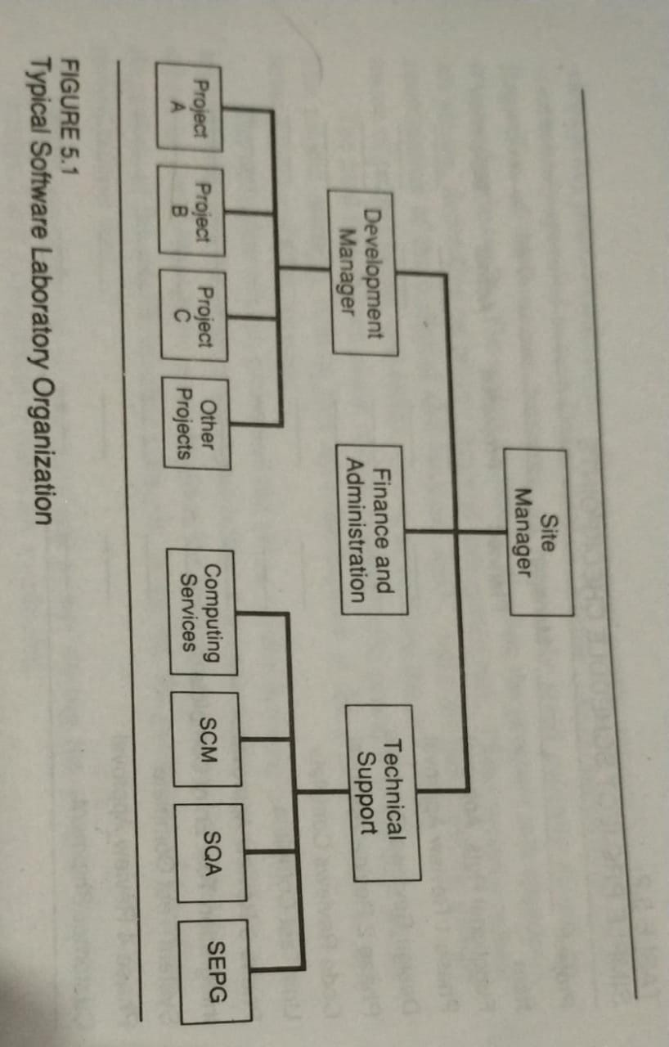

Slide 21
The summary report can be useful in identifying project status against specific checkpoints.
In addition to monitoring progress, the quarterly reviews maintain focus on organizational improvement. Organizational improvement is the matter of priorities.
For any improvements to be implemented, they must be given sufficient priority to get on the immediate action lists of some key people.
When the management team decides to make improvements, it must assign people to do the work.
If senior management does not intervene, no one will be assigned and nothing will be done. Staffing of organizational improvement tasks should be reviewed on a monthly basis.

Slide 22
The organization’s SEPG and SQA staff should conduct the quarterly management reviews.
The SQA staff assesses project and subcontractor status and SEPG covers management control, process status, technology status, quality and productivity tracking.
The primary focus of these reviews should be on financial and resource status and on establishing the technical staffs required to conduct more comprehensive reviews.

Slide 23
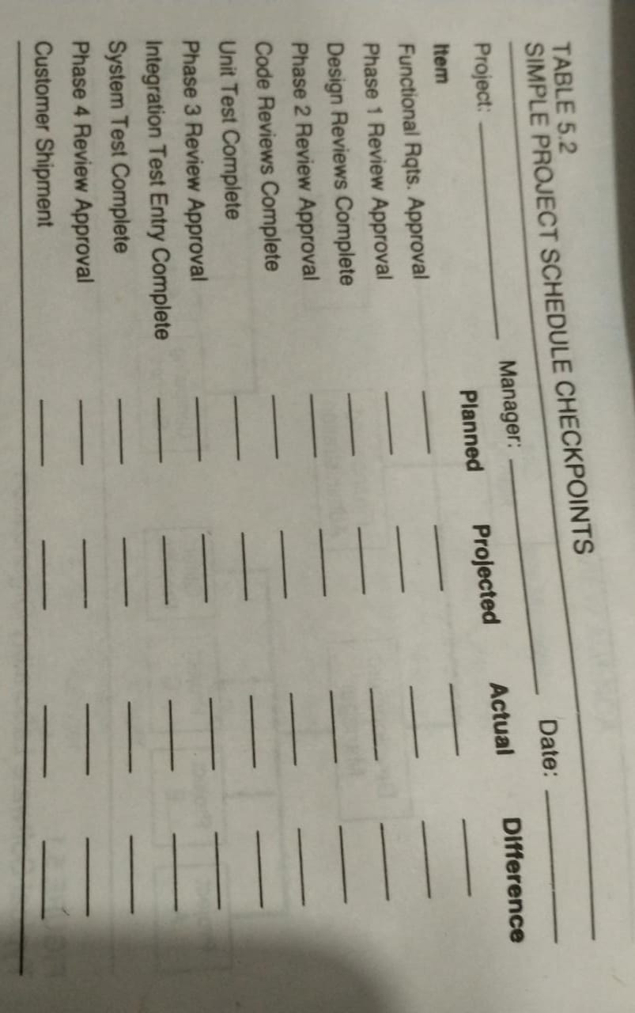

Slide 24
Project Phase Review
In addition to quarterly reviews, management must assess the project progress periodically. This is accomplished through a sequence of reviews at key points in each project. All sized projects should be reviewed periodically.
The review is done by dividing the program into appropriate phases, depending on project size and anticipated risk.
These reviews ensure coordination of the technical and business tasks, make all participating groups aware of project status, and either resolve or escalate the key issues.
The final step in phase review is approval to proceed to the next phase. The project manager obtains this agreement either at the phase review or at the escalation meeting.

Slide 25
The principles of the phase review process are
Before initiation and at predetermined points during the project, detailed technical and management reviews are conducted.
The review points are selected based on the criteria
Whenever major resource commitments are required
At key technical milestones such as project initiation, high-level design complete, prototype completion, unit test complete and so forth
At reasonable calendar intervals, with milestones established for short and long projects
The review is conducted by project manager
All involved line and staff organizations participate
The meeting is not to resolve issues but to identify them and assign resolution responsibility

Slide 26
The project manager, with finance and SQA, decide whether
The phase was successfully completed
After each resolution, the phase is to be considered complete
Another review is required
Escalation should be made to senior manager
The review is concluded, and project manager notifies senior management of the final conclusion, with a review report summarizing the key issues and responsibilities and dates for resolution

Slide 27
Establishing a Project Management System
The most important management review system is that conducted by the project management team itself.
If project management is not aware of and actively involved in project issues, no other management system can be fully effective.
Even with capable project managers, the effectiveness of the management system depends on the quality of the project schedules and resource estimates and the capability of SQA to monitor project performance.
The reports on progress against quality plans should be initiated.

Slide 28
The steps needed are
1. The commitment system is defined
What commitments require senior management approval
When are these approvals needed
What preparation and concurrences are required prior to requesting this approval
What are the mechanisms for stopping or delaying projects that have not been approved
2. The quarterly review system is established
What is to be covered and who will do it?
Who manages the agenda and schedule?
Who attends?
Who prepares the minutes and tracks the action items?

Slide 29
The phase review system is established
What projects are to be covered?
At what project checkpoints will phase reviews be conducted?
What special criteria will be used for very large and very small projects?
Who is responsible for scheduling and conducting the reviews?
Who is responsible for reporting the results and tracking the action items?
Who attends?
What are the procedures for handling issues and escalation?
What mechanisms ensure that projects do not proceed without successfully completing the phase review or receiving management exception approval?

Slide 30
The Project Plan
The project plan defines the work and how it will be done.
It provides a definition of each major task, an estimate of the time and resources required, and a framework for management review and control.
Project Planning Principles
The project plan is developed at the beginning of the job and is successively refined as the work progresses. Initially, since requirements are vague and incomplete, the focus is on determining where more knowledge is needed and how to get it.
Without this guidance, programmers often start building what they understand best, leaving the unknowns until later. Since the unknowns have the highest risk, this leads to trouble.

Slide 31
The logic for software project planning is
While requirements are initially vague and incomplete, a quality program can only be built from an accurate and precise understanding of the user’s needs. The project plan starts by mapping the route from vague and incorrect requirements to accurate and precise ones.
A conceptual design is then developed as a basis for planning. This initial structure must be produced with care since it defines the breakdown of the product into units, the allocation of functions to these units, and the relationships among them. This provides the organizational framework for planning and implementing the work, and is almost impossible to recover from a poor conceptual design.

Slide 32
At each subsequent requirements refinement, resource projections, size estimates, and schedules are also refined.
When the requirements are sufficiently clear, a detailed design and implementation strategy is developed and incorporated in the plan.
As various parts of the project become well understood, implementation details are established and documented in further plan requirements.
Throughout this cycle, the plan provides the framework for negotiating the time and resources to do the job.

Slide 33
Planning Considerations
With rare exceptions, initial resource estimates and schedules are unacceptable.
This is not because the programmers are unresponsive but because the users want more than they can afford.
If the job doesn’t fit the available schedule and resources, it must either be reduced gradually or the time and resources increased.
The planning negotiation is the critical test for a software management team.
The team must treat the initial plan as a starting point and when schedule or cost must be reduced, job scope must be cut as well.
While these negotiations proceed, it is crucial that the most important single factor in determining the delivery date is the date when work begins.
Until agreement is reached and the work can start, final delivery slips day by day.

Slide 34
The Planning Cycle
The following iterative plan negotiation process is followed
The cycle starts with the initial requirements.
The response to every demand for a commitment must be : ‘I understand your requirement and will produce a plan with that objective, but without a plan, I cannot make a commitment.
The plan is produced by first breaking the work into key elements, called Work Breakdown Structure (WBS). This implies that a conceptual design has been developed.
The size of each product element is estimated.
The resource needs are projected.
The schedule is produced.
The resulting schedule and estimate are then compared with the initial need, and, if they fit, the commitment can be made and work can proceed.
If, the cost is too high or the schedule is too long, requirements negotiation and re-planning are needed.

Slide 35
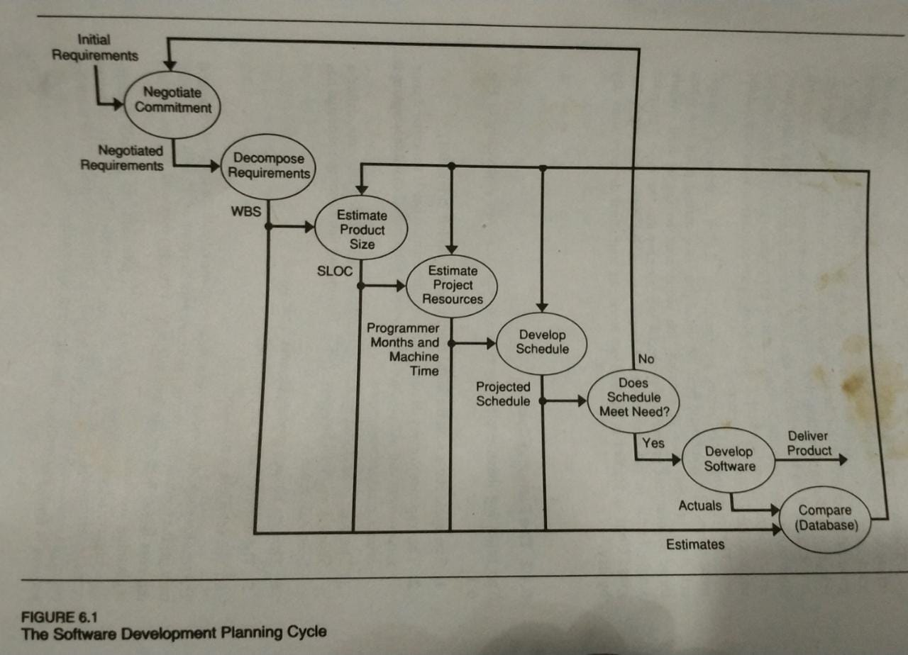
Software Development Planning Cycle

Slide 36
Project Plan Contents
The elements of a software plan are
Goals and objectives – These describe what is to be done, for whom and by when, as well as the criteria for determining project success.
Work Breakdown Structure – The WBS subdivides the project into tasks that are each defined, estimated and tracked.
Product Size Estimates – These are quantitative assessments of the code required for each product element.
Resource Estimates – Based on prior experience, known productivity factors are applied to yield reasonable estimates of the resources required for each WBS element.
Project Schedule – Based on the available project staffing and resource estimates, a schedule for the key tasks and deliverable items is produced.

Slide 37
In addition to defining the work, this plan provides management the basis for periodically reviewing and tracking progress against the plan.
As the work definition is progressively refined, the plan is periodically updated, the estimates are revised, and the schedules are reviewed.
These reviews and updates are managed through quarterly and phase review processes.

Slide 38
Goals and objectives
The project’s goals and objectives are established during the requirements phase. There is a negotiation between the software engineers and the users on what is to be done, how success will be measured, and how much time and resources are needed.
The user’s need change when they look closely at their problems, the requirements change as the work progresses.
Design and implementation effort must start with a stable requirements definition.
Requirements change is a continuing problem for software engineering.

Slide 39
The software team must follow few simple rules
Implement the product in small increment steps
Select each increment to support succeeding increments and/or improve requirements knowledge
Freeze the requirements for each increment step before starting design
When the requirements change during implementation, defer the change to a subsequent increment
If the changes cannot be deferred, stop work, modify the requirements, revise the plan, and start again on the design
These incremental steps are aimed at producing running code as soon as possible.
The process starts with minimal function and gradually expands until a functionally useful level is reached.
Then testing is done to validate the requirements before development proceeds.

Slide 40
The key considerations of the requirements phase are
Functional requirements : The product functions are listed, together with any performance or other constraints.
System needs : Target system configurations are specified, together with any standards, compatibility, or environmental constraints.
Customer identification : The users are identified, as well as their support needs, including delivery mechanisms, product packaging, installation support, documentation requirements and training.
Measures of success : Cost, schedule, performance, quality, size and other measures of success are quantified in advance. Such measures are often initially stated in general terms, and refined at each program phase.
Validation and acceptance : The means for determining success are established, including responsibility for acceptance testing, the criteria to be used, and any warranties or other consequences of failure.
Support : Continuing support requirements are stated, including defect reporting and correction and subsequent enhancement plans.

Slide 41
Work Breakdown Structure
Project planning starts with an estimate of the size of the product to be produced.
This estimation begins with a detailed and documented breakdown of the product into work elements.
The breakdown has two parts: the product structure and the software process.
The WBS then provides the framework for relating them. The product design has a hierarchical structure.
For larger jobs, the subsystems hierarchy might consist of systems, subsystems, products, components and modules.

Slide 42
A size estimate is then made of each product element. The prime considerations in making such estimates are
Start with as detailed a product structure as is technically possible
Precisely define the standard of measurement
Estimate the size of each product element
Sum these elements to produce a total estimate
Apply appropriate contingencies (future events)

Slide 43
Size Measures
The measure used in program size estimation should be reasonably easy to use early in the project and readily measurable once the work is completed.
Best measures of software size are Line-of-Code or Source Lines of Code (SLOC) and Function Points.
It is very difficult to relate the lines of code as the early estimates.
Function points start from the users perspective and estimate the size of the application.

Slide 44
Line-of-Code (LOC) Size Estimates
LOC estimates count all source instructions and exclude comments and blanks. Automated tools are designed to count semicolons. It is difficult to estimate lines of count from high-level requirements statements.
The advantage of LOC is that it directly relates to the product to be built. It can thus be measured after the fact and compared to the initial plans.
Function Points
The initial application requirements statements are examined to determine the number and complexity of the various inputs, outputs, calculations and databases required.
By using values, points are assigned to each of these counts. These points are then summed to produce the overall function point rating for the product.

Slide 45
Count the number of inputs, outputs, inquiries, master files and interfaces required
Multiply these counts by the following factors
Inputs 4
Outputs 5
Inquiries 4
Master files 10
Interfaces 10
Adjust the total of these products by +25%, 0, -25%, depending on the estimator’s judgment of the program’s complexity
While function points help in making early size estimates of application programs, they have drawbacks.
Thus it is advised that function points be used to make the initial estimates and then, based on experience these function points are converted to LOC. Planning then proceeds using LOC measure.

Slide 46
Estimating
Once a size measure has been established, an estimating procedure is needed.
A group of experts is each given the program’s specification and an estimation form
They meet to discuss the product and any estimation issues
They then each anonymously complete the estimation forms
The estimates are given to the estimate coordinator, who tabulates the results and returns them to the experts
Only each experts personal estimate is identified, all others are anonymous
The experts meet to discuss the results, revising their estimates as they feel appropriate
The cycle continues until the estimates converge to an acceptable range

Slide 47
Project Tracking
One requirement for sound project management is the ability to determine project status. The planning process should thus produce a schedule and enough checkpoints to permit periodic tracking. One way to this is with earned-value project scheduling. This is done as
Several checkpoints are determined for each project phase. These must each represent completion of precisely defined tasks, such as
Module specifications complete and approved
Module design complete, inspected and corrections made
Module unit test plan complete, reviewed and approved
Module coding complete and first clean compilation
Module code inspection complete and corrections made
Module through unit test and delivered to SCM for integration in the baseline
The resources required to complete each checkpoint are determine as a percent of the total project
This plan is plotted
As the project progresses, actual performance against the plan is tracked.

Slide 48
The Development Plan
After completing the estimates and schedule, the full development plan is assembled in a complete package and submitted to management for review and approval.
In addition to the estimate and schedule, many items can be included in such plans.
After preparation, the plan is circulated to all involved groups for review and sign-off. Every group must agree that the plan represents their commitments to do the work in the time and with the resources specified. This calls for a review and management signature by such groups as

Slide 49
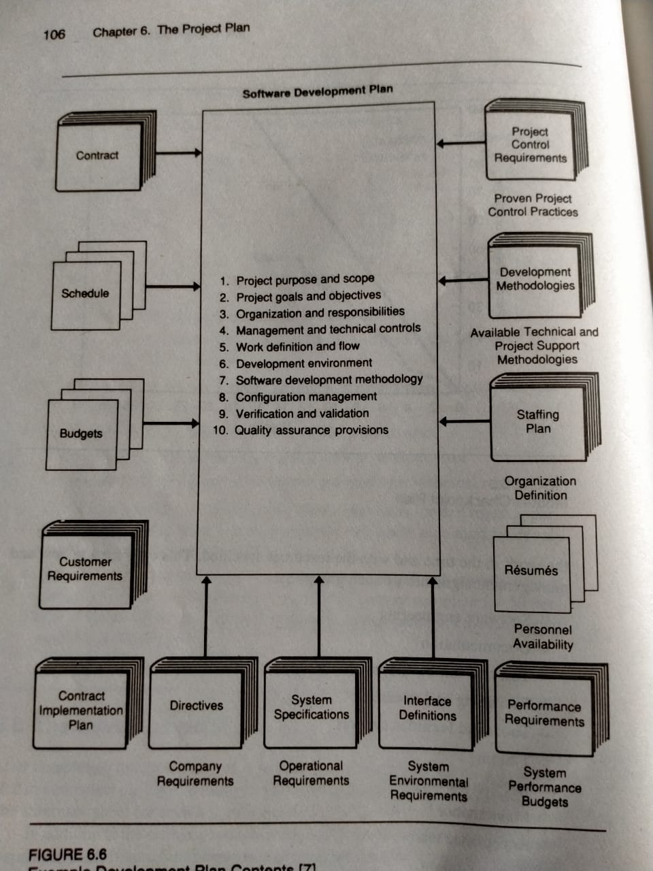

Slide 50
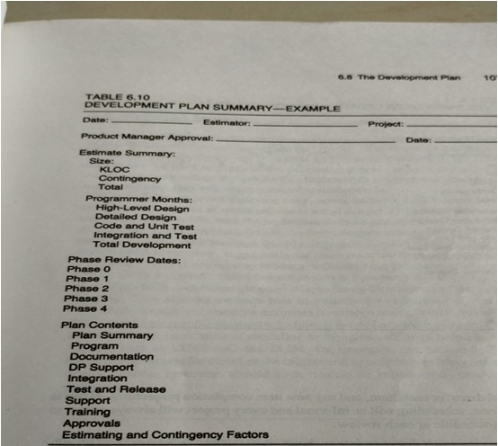

Slide 51
Software Engineering
Documentation
Test and test development
Packaging and release
Tools and facilities support
Training
Installation support
Maintenance
Acceptance test
Administration
Software Quality Assurance
At each phase review the development plan is updated. The schedules show task status and current projections compared to the plan. The development plan summary is updated to reflect changes in program size estimates, resources used to date, and projected phase review dates.

Slide 52
These regular uses of summaries quickly inform senior management of any significant changes in the program. Then phase review report should then inform them of the resolution of any schedule, resource or staffing issues.
Some of the items to be considered in phase reviews are
The base project schedule is retained and updated unless a major project change is introduced and a full re-planning cycle is completed and approved.
The final product delivery date is shown on the overall schedule, and all subsidiary schedules are posted against this master.
The development teams participate in planning their own work.
When a development schedule or estimate is outside the user’s acceptable range, it is rarely wise to arbitrarily make reductions.

Slide 53
Software Configuration Management
Change management is one of the fundamental activities of software engineering. Changes to the requirements drive the design and design changes affect the code. Testing then uncovers problems that result in further changes, sometimes even to the original requirements.
The change process is simple, but complex in detail. For modest-sized projects, the number of people involved and the change volume require a formal change management system.
The key objective of the software process is to have change activity converge until the final product is stable enough to ship, the management of all changes is important.

Slide 54
The need for configuration management
The most frustrating software problems are often caused by poor management. The problems are frustrating because they take time to fix, they often happen at the worst time, they are totally unnecessary.
Configuration management helps to reduce these problems by coordinating the work products of many different people who work on a common project. Without such control, their work will conflict, resulting in problems like
Simultaneous update – When two or more programmers work separately on the same program, the last one to make changes can easily destroy the other’s work.
Shared code – Often, when a bug is fixed in code shared by several programmers, some of them are not notified.
Common code – When common program functions are modified, all the users need to know. Without effective code management, there is no way to be sure of finding and alerting every user.
Versions – Most large programs are developed in evolutionary releases. With one release in customer use, another in test and the third in development, bug fixes may propagate between them.

Slide 55
The problems stem from confusion and lack of control and they waste an enormous amount of time. The key is to have a control system that answers the following questions
What is my current software configuration?
What is its status?
How do I control changes to my configuration?
How do I inform everyone else o my changes?
What changes have been made to my software?
Do anyone else’s changes affect my software?
The key role of Software Configuration Management (SCM) is to control change activity so these questions can be answered.

Slide 56
Software Product Nomenclature
The role of configuration management is to control the development of the system elements as they are built and then combined into a full system, it is important to use common system terminology.
The design process starts by successively partitioning the system until a satisfactory level of detail is reached. At this point, implementation begins with these smallest pieces, which are progressively assembled and tested until the total system is completed. Since there is no standardized nomenclature for these levels, the terms used are
System
Subsystem
Product
Components
Module

Slide 57
System – The package of all the software that meets the user’s requirements.
Subsystem – Large systems can have many subsystems, such as communications, display and processing.
Product - Subsystems typically contain many products. Example, operating system might contain a control program, compilers, utilities and so forth.
Components – At the next level, a control program could be made up of such components as a supervisor, scheduler and I/O control system.
Module – At the lowest level, components consist of a number o modules. Modules implement individual functions that are relatively small and self-constrained, such as queue management, interrupt dispatcher and command interpreter.

Slide 58
During the implementation process two things are happening at the same time.
The modules are developed, enhanced, tested and repaired from detailed design and implementation through system test.
The modules are being assembled into components, products, subsystems and systems. During this building process, the modules are constantly being changed to add functions or repair problems. This process is supported by a hierarchy of tests:
Unit test – This is a separate test of each individual module
Integration test – As the modules are integrated into components, products, subsystems and systems, their interfaces and interdependencies are tested to ensure they are properly designed and implemented
Function test – When integration results in a functionally operable build, it is tested successively in component test, product test, subsystem test and finally in system test
Regression test – At each integration test, a new build is produced. This is first tested to ensure that it hasn’t regressed or lost functions that were present in the previous build

Slide 59
Basic Configuration Management Functions
Once an initial product level has stabilized, a first baseline is established. With each successive set of enhancements, a new baseline is established in step with development.
Each baseline is retained in a permanent database, together with all the changes that produced it. The baseline is thus the official repository for the product, and it contains the most current version.
Only tested code and approved changes are put in the baseline, which is fully protected. It is the official source that all the programmers use to ensure their work is consistent with that of everyone else.
The key SCM tasks are Configuration Control, Change Management, Revisions, Versions, Deltas, Conditional Code.

Slide 60
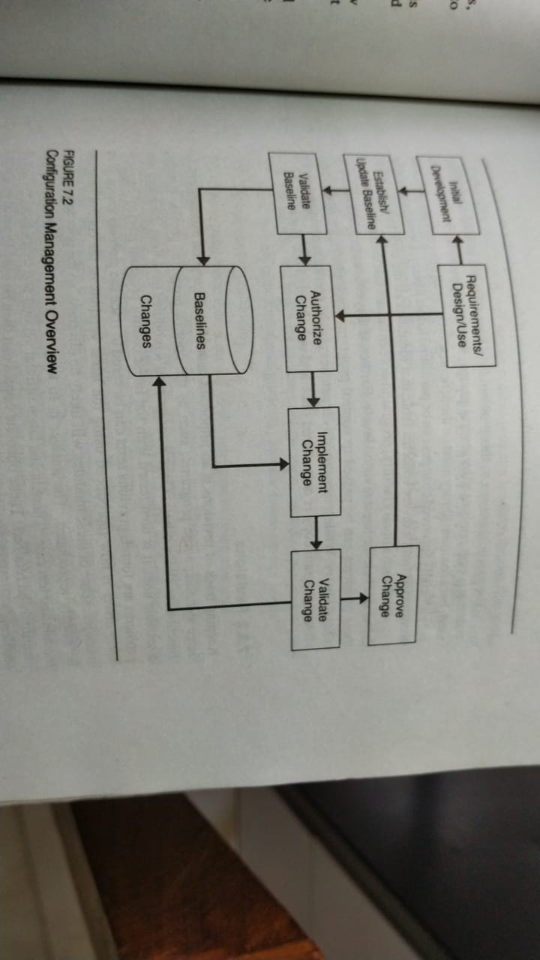

Slide 61
Baseline
The baseline is the foundation for configuration management. It provides the official standard on which subsequent work is based and to which only authorized changes are made. After an initial baseline is established and frozen, every subsequent change is recorded as delta until the next baseline is set.
It is desirable to establish a baseline at an early point in every project. Establishing a baseline too early will impose unnecessary procedures and slow the programmer’s work.
There are no rules in establishing early baselines. As soon as integration begins, formal control is essential.

Slide 62
Baseline Scope
For code control, the baseline contains all the project code. The items to be included for the implementation phase are
The current level of each module, including source and object code
The current level of each test case, including source and object code
The current level of each assembler, compiler, editor or other tool used
The current level of any special test or operational data
The current level of all macros, libraries and files
The current level of any installation or operating procedures
If the project involves operating system or control program changes, it may also be necessary to retain data on the computing system configuration and its change level
While it may not seem that critical to save every small change, some minor omission always seem to cause devastating problems in final system or acceptance testing. With large, complex systems, it is necessary to retain every change that could possibly occur.

Slide 63
Baseline Control
SCM must ensure appropriate baseline control while providing service to the programmers. The baseline must be protected against unauthorized change, and the programmer’s should be able to readily modify and test their code.
Every proposed change must then be tested against a trial version of the new baseline to make sure that it does not invalidate any of the other changes. Since tests take time and since changes are being made all the time, a locking mechanism is needed to ensure that none of these updated modules are changed during this final regression test.
An approach is to break the problem into two parts
Locking
Regression testing

Slide 64
Configuration Management Responsibilities
To implement the necessary controls and procedures, a number of responsibilities need to be established. Depending on the size of the system and the number of people involved, they may be handled by an individual, several people or an entire organization. The basic responsibilities are the Configuration Manager, Module Ownership, Change Control Board (CCB).
The configuration manager is the central control point for system change and has the following responsibilities
Develop, document, and distribute the SCM procedures
Establish the system baseline, including backup provisions
Ensure that no unauthorized changes are made to the baseline
Ensure that all baseline changes are recorded in sufficient detail so they can be reproduced or backed up
Ensure that all baseline changes are regression tested
Provide the focal point for exception resolution

Slide 65
The configuration manager ensures that answers are always available for such questions as
What code is this
What changed
What tests were run
What were the test results
Where is this code
For projects involving hundreds of people, entire SCM department may be needed.
Developed and tested code is expensive, and it must be retained and protected. That is the configuration manager’s basic responsibility.

Slide 66
Module Ownership
Even with a well-established and effective SCM function, provisions are also needed to ensure the design integrity of each module.
For example, when bugs are fixed, there are often alternative design approaches. If enhancements are also being considered, the bug repair should be consistent with future plans.
Maintaining design integrity is a common problem with periodic enhancements. One simple approach is to designate a programmer as owner of each module. Since there are often many modules than programmers, one person owns several modules at one time.

Slide 67
The Change / Configuration Control Board (CCB)
A change control mechanism is needed to ensure that every change is properly considered and coordinated. This is the role of CCB.
It should at least include members from development, documentation, test, assurance, maintenance and release. Its purpose is to ensure that every baseline change is properly considered by all concerned parties and that every change is authorized before implementation.
The CCB is the body that reviews each change request and approves it, disapproves it, or defers it for more information.

Slide 68
Each board must have a chairman with authority to resolve disputes. With multiple CCBs, a system-level CCB is needed as a resolution point for disputes between these lower-level boards.
A CCB needs the following information on each proposed change
Size : How many new and/or changed lines of code will likely be required
Alternatives : What, if any, are the alternatives to making the change and, if there is more than one way to do it, why was the proposed one selected?
Complexity : Is the change within a single component or does it involve others?
Schedule : What are the required and planned dates?
Impact : What are the future product consequences of this change?
Cost : What are the potential costs and savings from making the change?
Severity : How critical is the change?
Test : Are there any special test requirements?

Slide 69
Relationship to other changes : Will another change supersede or invalidate this one, or does it depend on other changes?
Resources : Are the needed people available to do the work?
System impact : What are the memory, performance, or other system consequences of the change?
Benefits : Are there special advantages to be derived from the change?
Politics : Are there special considerations such as who is requesting the change or whom it will affect?
Change maturity : How long has the change been under consideration?
If the change is to fix a customer-reported problem, other information may also be required
A definition of the problem the change is intended to fix
The conditions under which the problem was observed
A copy of trouble report
A technical description of the problem
The names of any other programs affected

Slide 70
Additional information should also be available prior to release
Final source and/or object code for the change
Final documentation changes
Evidence of successful inspection and test of the code and documentation
The CCB not only determines whether the change should be made but also the conditions under which it can be released.

Slide 71
Software Quality Assurance (SQA)
Quality Management
In software there are so many things that need to be done that the manager can’t possibly track them all. Since effective management of software requires many things to be precisely right, some organization is needed to do the tracking. This is the role of SQA.
Before establishing an SQA organization, it is essential to first decide how important software quality is to the organization.
SQA is a management tool that must be properly used to be effective. The prime benefit of SQA program is the assurance it provides management that the officially established process is actually being implemented.

Slide 72
The SQA ensures that
An appropriate development methodology is in place
The projects use standards and procedures in their work
Independent reviews and audits are conducted
Documentation is produced to support maintenance and enhancement
The documentation is produced during and not after development
Mechanisms are in place and used to control changes

Slide 73
Testing emphasizes all the high-risk product areas
Each software task is satisfactorily completed before the succeeding one is begun
Deviations from standards and procedures are exposed as soon as possible
The project is auditable by external professionals
The quality control work is itself performed against established standards
The SQA plan and the software development plan are compatible

Slide 74
Need for SQA
When quality is vital, some independent checks are necessary, not because people are untrustworthy, but because they are human. The issues with software are not whether checks are needed, but who does them and how.
Software managers monitor the work closely and that no SQA activity is needed. As the size of the staff grows, the managers become involved with other duties. They need to do one of the following
Find some way to handle their other workload so they can monitor more closely their people’s work
Hire someone to do the audit work
Motivate the people to monitor each other
This is when management must resort to the SQA solution.

Slide 75
The Goals of SQA
To improve software quality by appropriately monitoring both the software and the development process that produces it
To ensure full compliance with the established standards and procedures for the software and the software process
To ensure that any inadequacies in the product, the process or the standards are brought to the managements attention so these inadequacies can be fixed

Slide 76
The SQA organization is not responsible for producing quality products or for making quality plans.
SQA is responsible for auditing the quality of the line organization and for alerting management to any deviations.
To be effective, SQA needs to work closely with development.
They need to understand the plans, verify their execution, and monitor the performance of the individual tasks.
The key is an SQA attitude of cooperation and support.

Slide 77
The Role of SQA
The people responsible for the software projects are the only ones who can be responsible for quality.
The role of SQA is to monitor the way these groups perform their responsibilities.
Management must insist that the quality problems be fixed before the product is shipped; otherwise SQA becomes an expensive exercise.

Slide 78
SQA Responsibilities
SQA is assigned with the following responsibilities
Review all development and quality plans for completeness
Participate as inspection moderators in design and code inspections
Review all test plans for adherence to standards
Review a significant sample of all test results to determine adherence to standards to plans
Periodically audit SCM performance to determine adherence to standards
Participate in all project quarterly and phase reviews and register non-concurrence if the appropriate standards and procedures have not been reasonably met

Slide 79
SQA Functions : In establishing an SQA function, the basic organizational framework should include the following
Quality Assurance Practices :
Adequate development tools, techniques, methods, and standards are defined and available for use as standards for Quality Assurance review.
Software Project Planning Evaluation :
If adequate quality practices are not planned at the outset, they will not be implemented.
Requirements Evaluation :
Since high-quality products are rarely developed from low-quality requirements, the initial requirements must be reviewed for conformance to quality standards

Slide 80
Evaluation of Design Process :
Means are required to ensure that the design follows the planned methodologies, that it implements the requirements, and that the quality of the design itself is independently reviewed.
Evaluation of Coding Practices :
Appropriate coding practices must be established and used
Evaluating the Software Integration and Test Process :
A quality testing program has been established, testing is performed by an independent group that is both motivated and capable of finding problems, test planning begins early, and the quality of testing itself is reviewed.
In-process evaluation of the management and project control process :
By making sure that that the management processes are working. SQA helps ensure that the entire organization is focused on producing a quality result.
Tailoring of Quality Assurance procedures :
The SQA plan should be tailored to the unique needs of a project.

Slide 81
SQA Reporting
The simple rule of SQA reporting is that it not be under the software development manager. The guidelines followed are
SQA should not report to the project manager
SQA should report somewhere within the local laboratory or plant organization
There should typically be no more than one management position between SQA and the senior location manager
SQA should always have a dotted line relationship to a senior corporate quality executive
Whenever possible, SQA should report to someone who has interest in software quality, like the staff head responsible for field service

Slide 82
Launching the SQA Program
The eight steps for launching an SQA program are
Initiate the SQA program – The key SQA roles are defined and management publicly commits to them. This results in documented goals and responsibilities and an identified leader
Identify SQA issues – The SQA leader and initial staff work with project management to identify the key issues for SQA attention
Write the SQA plan – The SQA plan defines SQA’s audit and control activities and identifies the required standards and procedures. The SQA plan is integrated with SCM and project plans
Establish standards – The standards and procedures that guide SQA are developed and approved. Any special project provisions are also reviewed and approved

Slide 83
Establish the SQA function – The SQA function is staffed to perform the established plan
Conduct training and promote the SQA program – SQA personnel are briefed on the SQA plan and given needed training on the project and SQA methods. Appropriate meetings and reviews are held to acquaint project personnel with the purpose and roles of SQA
Implement the SQA plan – Each key SQA activity is assigned to specific SQA personnel, a schedule is developed, management monitoring is established, and an issue resolution system is implemented
Evaluate the SQA program – The SQA function is periodically audited to determine its effectiveness in performing its mission. Needed corrective actions are identified and implemented.

Slide 84
The SQA plan
Each development and maintenance project should have a Software Quality Assurance Plan (SQAP) that specifies its goals, the SQA tasks to be performed, the standards against which the development work is to be measured, and the procedures and organizational structure.
The IEEE standard for SQAP preparation contains the following outline
Purpose
Reference Documents
Management
Documentation
Standards, Practices and Conventions
Reviews and audits
SCM
Problem Reporting and Corrective Action

Slide 85
Tools, Techniques, and Methodologies
Code Control
Media Control
Supplier Control
Records Collection, Maintenance and Retention
SQA Considerations
Many Software Quality Assurance organizations fail to have much impact on software quality. While there are many potential reasons, the most common are
SQA organizations are rarely staffed with sufficiently experienced or knowledgeable people
The SQA management team is often not capable of negotiating with development
Senior management often backs development over SQA on a large percentage of issues
Many SQA organizations operate without suitably documented and approved development standards and procedures
Software development groups rarely produce verifiable quality plans

Slide 86
SQA People
Getting good people in SQA is one of the most difficult problems software managers face.
One effective solution is to require that all new development managers be promoted from SQA. While this is an extreme measure, it can be effective.
For SQA to be effective, they must have good people and full management backing

Slide 87
Independent Verification and Validation (IV & V)
It is common to have a separate Independent Verification and Validation organization involved. Its role is to provide an independent monitor of the development or maintenance organization’s performance.
There might be confusion regarding the relative roles of IV&V and SQA.
Development management uses SQA to monitor its own organization and to ensure that established standards and procedures are followed. IV&V does essentially the same thing for the customer.
IV&V can and should capitalize on the existence of SQA. If SQA is working effectively, IV&V need not duplicate its work, and if it is not, IV&V must try to replace it. Their role is to highlight this shortcoming and to get it fixed.
IV&V role is to ensure that the customers needs are adequately reflected in the work.
The crucial role of IV&V is to ensure that the right skills and attitudes are in place.

