Slide 1
WORKFLOWS OF THE PROCESS
The activities of the process are organized into seven major workflows
Management
Environment
Requirements
Design
Implementation
Assessment
Deployment

Slide 2
These activities are performed concurrently, with varying levels of effort and emphasis as a project progresses through the life cycle.
The management workflow is concerned primarily with three disciplines.
Planning
Project Control
Organization

Slide 3
Most processes use sequences of activities as their primary representation format.
Sequentially oriented process descriptions are simple to understand, represent, plan and conduct.
From an individual’s point of view, all activities are inherently sequential.
Simplistic activity sequences are not realistic on software projects that are team efforts. Such efforts may include many teams, making progress on many artifacts that need to be synchronized, cross-checked, homogenized, merged and integrated.
This distributed nature of the software process and its subordinate workflows is the primary source of management complexity.

Slide 4
One of the flaws in conventional software process was presenting the life cycle as a sequential thread of activities, from requirements to design to code to test to delivery.
A modern process avoids the life cycle phases after the predominant activities.
The phases – inception, elaboration, construction and transition – specify the state of the project rather than a sequence of activities.
The intent is to recognize explicitly the amount of activities in all phases and avoid the interference that there is a sequential progression from requirements to design to code to test to delivery.

Slide 5
Software Process workflows
The macroprocess comprises discrete phases and iterations, but not discrete activities. A range of activities occurs in each phase and iteration.
The next-level process description is the microprocess or workflows, that produce the artifacts.
The term workflow is used to mean a thread of cohesive and mostly sequential activities. Workflows are mapped to product artifacts and project teams.
There are seven top-level workflows.
Management workflow : Controlling the process and ensuring win conditions for all stakeholders.
Environment workflow : Automating the process and evolving the maintenance environment.

Slide 6
Requirements workflow : Analyzing the problem space and evolving the requirements artifacts.
Design workflow : Modeling the solution and evolving the architecture and design artifacts.
Implementation workflow : Programming the components and evolving the implementation and deployment artifacts.
Assessment workflow : Assessing the trends in process and product quality.
Deployment workflow : Transitioning the end products to the user.

Slide 7
The principles of process framework are :
Architecture-first approach :
Extensive requirements analysis, design implementation, and assessment activities are performed before the construction phase, when full-scale implementation is the focus.
This early life-cycle focus on implementing and testing the architecture must precede full-scale development and testing of all the components and must precede the downstream focus on completeness and quality of the entire breadth of the product features.
Iterative life-cycle process :
Each phase portrays at least two iterations of each workflow.
Some projects may require only one iteration in a phase; others may require several iterations.
The point is that the activities and artifacts of any given workflow may require more than one pass to achieve adequate results.

Slide 8
Round – trip engineering
Raising the environment activities to a first-class workflow is critical.
The environment is the tangible embodiment of the project’s process, methods, and notations for producing the artifacts.
Demonstration – based approach
Implementation and assessment activities are initiated early in the life cycle, reflecting the emphasis on constructing executable subsets of the evolving architecture.
Some of the themes of the conventional process are not carried over in the workflows of the modern process. Their absence is equally important.
Documentation is omitted because most documentation should be merely a secondary by-product of the other activities.
Quality assurance is omitted because it is worked in all activities and not separated into a distinct workflow that operates independently from engineering or management,

Slide 9
Activity levels across the life – cycle phases
Inception
Elaboration
Construction
Transition
Management
Environment
Requirements
Design
Implementation
Assessment
Deployment

Slide 10
The artifacts and life – cycle emphases associated with each workflow
WORKFLOW ARTIFACTS LIFE – CYCLE PHASE EMPHASES
Management Business case Inception : Prepare business case and vision
Software Elaboration : Plan development plan development
Status assessments Construction : Monitor and control development
Vision
Transition : Monitor and control deployment
Work breakdown
structure

Slide 11
WORKFLOW ARTIFACTS LIFE – CYCLE PHASE EMPHASES
Environment Environment Inception : Define development environment and change management infrastructure
Software change
order database Elaboration : Install development environment and establish change management database
Construction : Maintain development environment and software change order database
Transition : Transition maintenance environment and software change order database

Slide 12
WORKFLOW ARTIFACTS LIFE – CYCLE PHASE EMPHASES
Requirements Requirements set Inception : Define operational concept
Release specifications Elaboration : Define architectural objectives
Vision Construction : Define iteration objectives
Transition : Refine release objectives

Slide 13
WORKFLOW ARTIFACTS LIFE – CYCLE PHASE EMPHASES
Design Design set Inception : Formulate architecture concept
Architecture description Elaboration : Achieve architecture baseline
Construction : Design components
Transition : Refine architecture and components

Slide 14
WORKFLOW ARTIFACTS LIFE – CYCLE PHASE EMPHASES
Implementation Implementation set Inception : Support architecture prototypes
Deployment set Elaboration : Produce architecture baseline
Construction : Produce complete componentry
Transition : Maintain components

Slide 15
WORKFLOW ARTIFACTS LIFE – CYCLE PHASE EMPHASES
Assessment Release specifications Inception : Assess plans, vision, prototypes
Release descriptions Elaboration : Assess architecture
User manual Construction : Assess interim releases
Deployment set Transition : Assess product releases

Slide 16
WORKFLOW ARTIFACTS LIFE – CYCLE PHASE EMPHASES
Deployment Deployment set Inception : Analyze user community
Elaboration : Define user manual
Construction : Prepare transition materials
Transition : Transition product to user

Slide 17
Iteration workflows
An iteration consists of a loosely sequential set of activities in various proportions, depending on where the iteration is located in the development cycle.
Each iteration is defined in terms of a set of allocated usage scenarios. The components needed to implement all selected scenarios are developed and integrated with the results of previous iterations.
An individual iteration’s workflow includes the following sequence :
Management :
Iteration planning to determine the content of the release and develop the detailed plan for the iteration
Assignment of work packages or tasks to the development team.
Environment :
Evolving the software change order database to reflect all new baselines and changes to existing baselines for all product, test, and environment components.

Slide 18
Requirements :
Analyzing the baseline plan, the baseline architecture, and the baseline requirements set artifacts to fully elaborate the use cases to be demonstrated at the end of this iteration and their evaluation criteria
Updating any requirements set artifacts to reflect changes necessitated by results of this iteration’s engineering activities.
Design :
Evolving the baseline architecture and the baseline design set artifacts to elaborate fully the design model and test model components necessary to demonstrate against the evaluation criteria allocated to this iteration
Updating design set artifacts to reflect changes necessitated by the results of this iteration’s engineering activities.
Implementation :
Developing or acquiring any new components, and enhancing or modifying any existing components
To demonstrate the evaluation criteria allocated to this iteration, integrating and testing all new and modified components with existing baselines.

Slide 19
Assessment :
Evaluating the results of the iteration, including compliance with the allocated evaluation criteria and the quality of the current baselines
Identifying any rework required and determining whether it should be performed before deployment of this release or allocated to the next release
Assessing results to improve the basis of the subsequent iteration’s plan
Deployment :
Transitioning the release either to an external organization (such as user, independent verification and validation contractor, or regulatory agency) or
To internal closure by conducting a post mortem so that lessons learned can be captured and reflected in the next iteration.

Slide 20
Iterations in the inception and elaboration phases focus on management, requirements, and design activities.
Iterations in the construction phase focus on design, implementation, and assessment.
Iterations in the transition phase focus on assessment and deployment.
An iteration represents the state of the overall architecture and the complete deliverable system.
An increment represents the current work in progress that will be combined with the preceding iteration to form the next iteration.

Slide 21
The workflow of an iteration
Allocated usage
scenarios
Results from the
previous iteration
Management
Requirements
Design
Implementation
Assessment
Deployment
Up-to-date risk assessment
Controlled baselines of artifacts
Demonstrable results
Requirements understanding
Design features/performance
Plan credibility
Results for the
next iteration

Slide 22
Iteration emphasis across the life-cycle
Management
Inception and Elaboration Phases
Requirements
Design
Implementation
Assessment
Deployment
Management
Requirements
Design
Implementation
Assessment
Deployment
Construction Phase

Slide 23
Management
Requirements
Design
Implementation
Assessment
Deployment
Transition Phase

Slide 24
CHECKPOINTS OF THE PROCESS
It is always important to have visible milestones in the life cycle where various stakeholders meet, face to face, to discuss progress and plans.
The purpose of these events is not only to demonstrate how well a project is performing but also to achieve -
Synchronize stakeholder expectations and achieve concurrence on three evolving perspectives : the requirements, the design and the plan.
Synchronize related artifacts into a consistent and balanced state.
Identify the important risks, issues, and out-of-tolerance conditions.
Perform a global assessment for the whole life cycle, not just the current situation of an individual perspective or intermediate project.

Slide 25
Milestones must have well-defined expectations and provide tangible results.
This does not preclude the renegotiation of the mile stone’s objectives once the project has gained further understanding of the requirements, design and plan.

Slide 26
KEY POINTS
Three sequences of the project checkpoints are used to synchronize stakeholder expectations throughout the life cycle : major milestones, minor milestones, and status assessments.
The most important major milestone is usually the event that transitions the project from the elaboration phase into the construction phase.
The format and content of minor milestones are highly dependent on the project and the organizational culture.
Periodic status assessments are crucial for focusing continuous attention on the evolving health of the project and its dynamic priorities.

Slide 27
Three types of joint management reviews are conducted throughout the process :
Major milestones : These system wide events are held at the end of each development phase. They provide visibility to system wide issues, synchronize the management and engineering perspectives, and verify that the aims of the phase have been achieved.
Minor milestones : these iteration-focused events are conducted to review the content of an iteration in detail and to authorize continued work.
Status assessments : These periodic events provide management with frequent and regular insight into the progress being made.
Each of the four phases-inception, elaboration, construction, and transition-consists of one or more iterations and concludes with a major milestone when a planned technical capability is produced in demonstrable form.

Slide 28
An iteration represents a cycle of activities for which there is a well-defined intermediate result, a minor milestone, captured with two artifacts :
A release specification ( the evaluation criteria and plan )
A release description ( the results )
Major milestones at the end of each phase use
Formal
Stakeholder-approved evaluation criteria and
Release descriptions
Minor milestones use
Informal
Development-team-controlled versions of these artifacts.

Slide 29
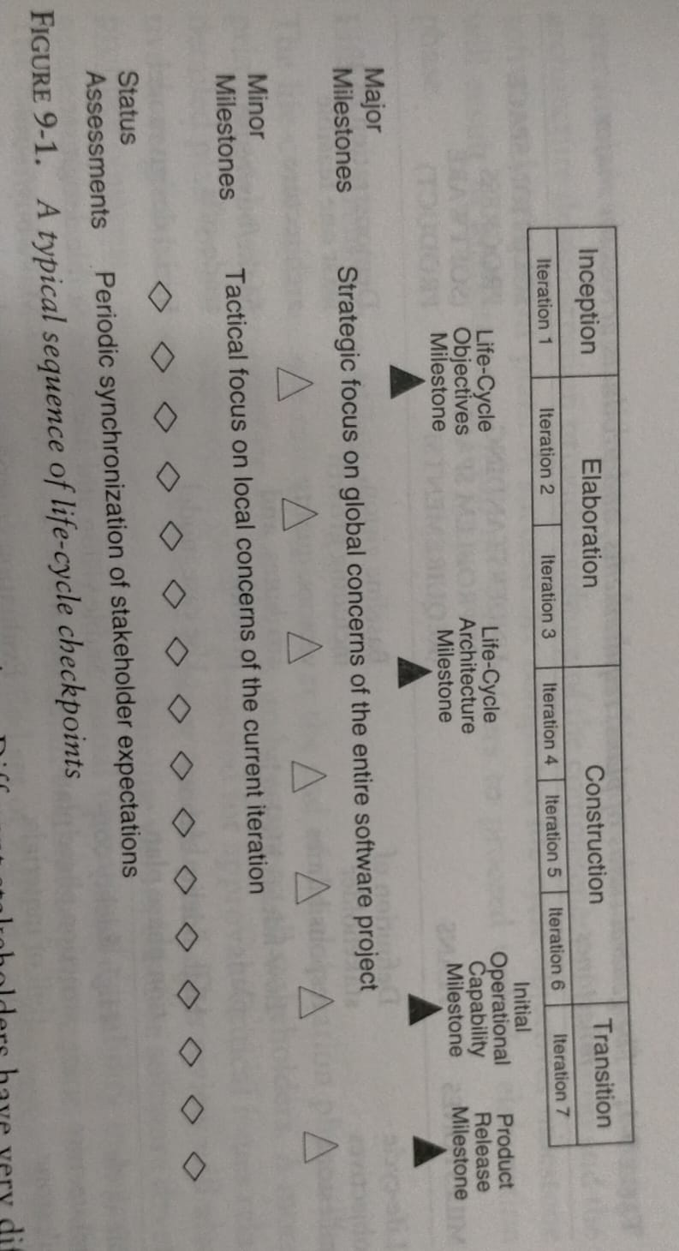
A sequence of life-cycle checkpoints

Slide 30
Major milestones
The four major milestones occur at the transition points between life – cycle phases.
They can be used in many different process models, including the conventional waterfall model.
In an iterative model, the major milestones are used to achieve concurrence among all stakeholders on the current state of the project.
Different stakeholders have different concerns :
Customers : Schedule and budget estimates, feasibility, risk assessment, requirements understanding, progress, product line compatibility.
Users : Consistency with requirements and usage scenarios, potential for accommodating growth, quality attributes.

Slide 31
Architects and systems engineers : Product line compatibility, requirements changes, trade-off analysis, completeness and consistency, balance among risk, quality and usability.
Developers : Sufficiency of requirements detail and usage scenario descriptions, frameworks for component selection or development, resolution of development risk, product line compatibility, sufficiency of the development environment.
Maintainers : Sufficiency of product and documentation artifacts, understandability, interoperability with existing systems, sufficiency of maintenance environment.
Others : Possibly many other perspectives by stakeholders such as regulatory agencies, independent verification and validation contractors, venture capital investors, subcontractors, associate contractors, and sales and marketing teams.

Slide 32
The milestones described may be conducted as one continuous meeting of all concerned parties or incrementally through mostly on-line review of the various artifacts.
The essence of each major milestone is to ensure that the requirements understanding, the life-cycle plans, and the product’s form, function and quality are evolving in balanced levels of detail and to ensure consistency among the various artifacts.

Slide 33
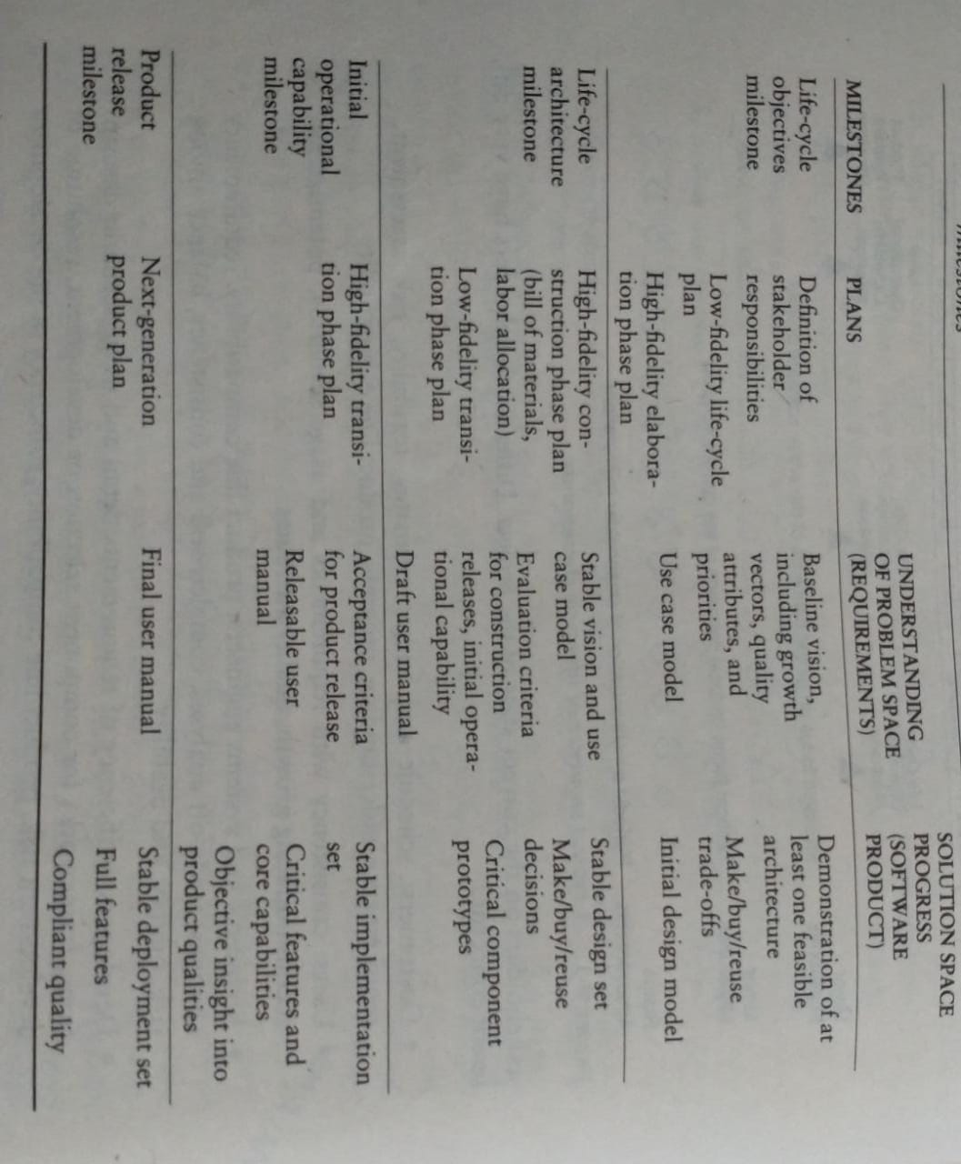
Status of plans, requirements and products across major milestones

Slide 34
Life–Cycle Objectives Milestone
It occurs at the end of the inception phase.
Its goal is to present to all stakeholders a recommendation on how to proceed with development, including a plan, estimated cost and schedule, and expected benefits and cost savings.
The vision statement and the critical issues relative to requirements and the operational concept are addressed.
A draft architecture document and a prototype architecture demonstration provide evidence of the completeness of the vision and the software development plan.
A successfully completed life-cycle objectives milestone will result in authorization from all stakeholders to proceed with the elaboration phase.

Slide 35
Life–Cycle Architecture Milestone
It occurs at the end of the elaboration phase.
Its primary goal is to demonstrate an executable architecture to all stakeholders.
A more detailed plan for the construction phase is presented for approval.
Critical issues related to requirements and the operational concept are addressed.
This review will also produce agreement on a baseline architecture, baseline vision, baseline software development plan, and evaluation criteria for the initial operational capability milestone.

Slide 36
The baseline architecture consists of both a human-readable representation and a configuration-controlled set of software components captured in the engineering artifacts.
A successfully completed life-cycle architecture milestone will result in authorization from the stakeholders to proceed with the construction phase.
The most important major milestone is the event that transitions the project from the elaboration phase into the construction phase, the content of the milestone is elaborated here in more detail.
From management and contractual standpoint, this major milestone corresponds to achieving a software development state in which the research and development stage is concluding and the production stage is initiated.

Slide 37
A software development project ready for this transition exhibits the following characteristics :
The critical use cases have been defined, agreed upon by stakeholders, and codified into a set of scenarios for evaluating the evolving architecture.
A stable architecture has been baselined in the source language format. Stability means that the important qualities of the architecture (performance, robustness, scalability, adaptability) have been demonstrated against the critical use cases to resolve all major requirements and design and planning risks.
The risk profile is well understood.
The development plan for the construction and transition phases is defined with enough fidelity that construction can proceed with predictable results.

Slide 38
Engineering artifacts available at the life-cycle architecture milestone
I Requirements
A. Use case model
B. Vision document (text, use cases)
C. Evaluation criteria for elaboration (text, scenarios)
II Architecture
A. Design view (object models)
B. Process view (if necessary, run-time layout, executable code structure)
C. Component view (subsystem layout, make/buy/reuse component identification)
D. Deployment view (target run-time layout, target executable code structure)
E. Use case view (test case structure, test result expectation)
1. Draft user manual
III Source and executable libraries
A. Product components
B. Test components
C. Environment and tool components

Slide 39
Default agendas for the life-cycle architecture milestone
Presentation Agenda
I. Scope and objectives (Demonstration overview)
II. Requirements assessment (Project vision and use cases, Primary scenarios and evaluation criteria)
III. Architecture assessment (Progress, Quality)
IV. Construction phase plan assessment (Iteration content and use case allocation, next iterations detailed plan and evaluation criteria, elaboration phase cost/schedule performance, construction phase resource plan and basis of estimate, risk assessment)
Demonstration Agenda
I. Evaluation criteria
II. Architecture subset summary
III. Demonstration environment summary
IV. Scripted demonstration scenarios
V. Evaluation criteria results and follow-up items

Slide 40
Initial Operational Capability Milestone
It occurs late in the construction phase.
The goals are to assess the readiness of the software to begin the transition into customer/user sites and to authorize the start of accepting testing,.
Issues are addressed concerning installation instructions, software version descriptions, user and operator manuals, and the ability of the development organization to support user sites.
Software metrics quality are reviewed to determine whether quality is sufficient for transition.
The readiness of the test environment and the test software for acceptance testing is assessed.
Acceptance testing can be done incrementally across multiple iterations or can be completed entirely during the transition phase.

Slide 41
The initiation of the transition phase is not necessarily the completion of the construction phase.
These phases typically overlap until an initial product is delivered to the user for self-sufficient operation.

Slide 42
Product Release Milestone
It occurs at the end of transition phase.
Its goal is to assess the completion of the software and its transition to the support organization.
The results of acceptance testing are reviewed, and all open issues are addressed.
These issues could include installation instructions, software version descriptions, user and operator manuals, software support manuals, and the installation of the development environment at the support sites.
Software quality metrics are reviewed to determine whether quality is sufficient for transition to the support organization.

Slide 43
Minor milestones
The number of iteration-specific, informal milestones depends on the content and length of the iteration.
Only two minor milestones are needed :
The iteration readiness review : This informal milestone is conducted at the start of each iteration to review the detailed iteration plan and the evaluation criteria that have been allocated to this iteration.
The iteration assessment review : This informal milestone is conducted at the end of each iteration to assess the degree to which the iteration achieved its objectives and satisfied its evaluation criteria, to review iteration results, to review qualification results, to determine the amount of rework to be done, and to review the impact of the iteration results on the plan for subsequent iterations.

Slide 44
For longer iterations, more intermediate review points may be necessary.
All iterations are not created equal.
An iteration can take on very different forms and priorities, depending on where the project is in the life cycle.
Early iterations focus on analysis and design, with substantial elements of discovery, experimentation, and risk assessment.
Later iterations focus much more on completeness, consistency, usability, and change management.

Slide 45
The milestones of an iteration and its associated evaluation criteria need to focus the engineering activities on the project priorities as defined in the overall software development plan, business case, and vision.
The format and content of these minor milestones tend to be highly dependent on the project and organizational culture.

Slide 46
Typical minor milestones in the life cycle of an iteration
Management
Requirements
Design
Implementation
Assessment
Iteration N - 1
Iteration N + 1
Deployment
Iteration N
Iteration N Initiation
Iteration Readiness Review
Iteration Design Walkthrough
Iteration Assessment Review
Iteration N Closeout

Slide 47
Periodic Status Assessments
Managing risks require continuous attention to all the interacting activities of a software development effort.
Periodic status assessments are management reviews conducted at regular intervals to address progress and quality indicators, ensure continuous attention to project dynamics, and maintain open communications among all stakeholders.
The principal objective of these assessments is to ensure that the expectations of all stakeholders are synchronized and consistent. Stakeholders can be contractor, customer, user, subcontractor.
They serve as project snapshots.

Slide 48
Status assessments provide the following :
A mechanism for openly addressing, communicating, and resolving management issues, technical issues, and project risks.
Objective data derived directly from on-going activities and evolving product configurations.
A mechanism for disseminating process, progress, quality trends, practices, and experience information to and from all stakeholders in an open forum.
Recurring themes from unsuccessful projects include status assessments that are
High-overhead activities, because the work associated with generating the status is separate from the everyday work.
Frequently cancelled, because of higher priority issues that require resolution.

Slide 49
Recurring themes from successful projects include status assessments that are
Low-overhead activities, because the material already exists as everyday management data
Rarely cancelled, because they are considered too important.
They are crucial for focusing continuous attention on the evolving health of the project and its dynamic priorities.
They force the software project manager to collect and review the data periodically, force outside peer review, and encourage dissemination of best practices to and from other stakeholders.

Slide 50
Default content of status assessment reviews
Personnel : a) Staffing plan Vs. Actual s
b) Attritions, Additions
Financial Trends : a) Expenditure plan Vs. Actual for the previous, current, and next major milestones
b) Revenue forecasts
Top 10 risks : a) Issues and criticality resolution plans
b) Quantification ( cost, time, quality ) of exposure
Technical progress : a) Configuration baseline schedules for major milestones b) software management metrics and indicators
c) Current change trends
d) Test and quality assessments
Major milestone a) Plan, schedule, and risks for the next major plans and results milestone b) Pass/fail results for all acceptance criteria
Total product scope : a) Total size, growth, and acceptance criteria perturbations

Slide 51
SOFTWARE MANAGEMENT DISCIPLINES
ITERATIVE PROCESS PLANNING
Like software development, project planning requires an iterative process.
Plans have an engineering stage, during which the plan is developed, and a production stage, when the plan is executed.
Plans must evolve as the understanding evolves of the problem space and the solution space.
Planning errors are just like product errors : the sooner in the life cycle they are resolved, the less impact they have on project success.

Slide 52
Work Breakdown Structure :
For a software project success, a good WBS and its synchronization with the process framework are critical factors.
The development of WBS is dependent on the project management style, organizational culture, customer preference, financial constraints, and several other hard-to-define, project-specific parameters.
A WBS is simply a hierarchy of elements that decomposes the project plan into the discrete work tasks.
A WBS provides the following information structure :
A description of all significant work.
A clear task decomposition for assignment of responsibilities.
A framework for scheduling, budgeting, and expenditure tracking.

Slide 53
Conventional WBS Issues – It suffers from three fundamental drawbacks :
They are prematurely structured around the product design.
They are prematurely decomposed, planned, and budgeted in either too much or too little detail.
They are project-specific, and cross-project comparisons are usually difficult or impossible.

Slide 54
Conventional work breakdown structures are prematurely structures around the product design
It is structured primarily around the subsystems of its product architecture, then further decomposed into the components of each subsystem.
Once this structure is ingrained in the WBS and then allocated to responsible managers with budgets, schedules, and expected deliverables, a concrete planning foundation has been set that is difficult and expensive to change.
A WBS is the architecture for the financial plan.
A loose coupling is desirable if either the plan or architecture is subject to change.

Slide 55
Conventional work breakdown structures are prematurely decomposed, planned, and budgeted in either too little or too much detail
Large software projects tend to be over planned, and small projects tend to be under planned.
The management team plan out each element completely and creates a baseline budget and schedule for every task at the same level of detail.
Most small-scale developments elaborate their WBSs to a single level only, with no supporting detail.
The management team plans and conducts the project with coarse tasking and cost and schedule accountability.
A WBS elaborated to at least two or three levels makes sense.

Slide 56
Conventional work breakdown structures are project-specific, and cross-project comparisons are usually difficult or impossible
Most organizations allow individual projects to define their own project-specific structure tailored to the project manager’s style, the customer’s demands, or other project-specific preferences.
With no standard WBS structure, it is extremely difficult to compare plans, financial data, schedule data, organizational efficiencies, cost trends, productivity trends, or quality trends across multiple projects.
Each project organizes the work differently and uses different units of measures.

Slide 57
Conventional WBS, following the product hierarchy :
Management
System requirements and design
Subsystem 1
Component 11
Requirements
Design
Code
Test
Documentation
…. ( similar structures for other subsystems )
Subsystem M
Component M1
Requirements
Design
Code
Test

Slide 58
Documentation
…. ( similar structures for other components )
Component MN
Requirements
Design
Code
Test
Documentation
Integration and test
Test planning
Test procedure preparation
Testing
Test reports
Other support areas
Configuration control
Quality assurance
System administration

Slide 59
Evolutionary Work Breakdown Structure
It should organize the planning elements around the process framework rather than the product framework.
It better accommodates the expected changes in the evolving plan and allows the level of planning fidelity to evolve in a straightforward way.
The basic recommendation for the WBS is to organize the hierarchy as
First-level WBS elements are the workflows. These elements are usually allocated to a single team and constitute the structure of a project for the purposes of planning and comparison with other projects.
Second-level elements are defined for each phase of the life cycle. These elements allow the fidelity of the plan to evolve more naturally with the level of understanding of the requirements and architecture, and the risks therein.

Slide 60
Third-level elements are defined for the focus of activities that produce the artifacts of each phase. These elements may be the lowest level in the hierarchy that collects the cost of a discrete artifact for a given phase, or they may be decomposed further into several lower level activities that, taken together, produce a single artifact.
A default WBS is consistent with the process framework (phases, workflows, and artifacts ).
It provides a framework for estimating the costs and schedules of each element, allocating them across a project organization, and tracking expenditures.

Slide 61
Planning Guidelines
It is valuable but risky to make specific planning recommendations independent of project.
It is valuable because people in management positions know that initial planning guidelines capture the expertise and experience of many other people.
Project-independent planning is risky.
There is a risk that the guidelines may be adopted blindly without being adapted to specific project circumstances. There is also the risk of misinterpretation.
Two simple planning guidelines should be considered when a project plan is being initiated or assessed.
The first guideline prescribes a default allocation of costs among the first-level WBS elements.
The second guideline prescribes the allocation of effort and schedule across the life cycle phases.

Slide 62
WBS budgeting defaults
FIRST-LEVEL DEFAULT
WBS ELEMENT BUDGET
Management 10 %
Environment 10 %
Requirements 10 %
Design 15 %
Implementation 25 %
Assessment 25 %
Deployment 5 %
Total 100 %

Slide 63
Default distributions of effort and schedule by phase
DOMAIN INCEPTION ELABORATION CONSTRUCTION TRANSITION
Effort 5 % 20 % 65 % 10 %
Schedule 10 % 30 % 50 % 10 %
Evolution of planning in WBS over the life cycle
Inception Elaboration
WBS Element Fidelity WBS Element Fidelity
Management High Management High
Environment Moderate Environment High
Requirements High Requirements High
Design Moderate Design High
Implementation Low Implementation Moderate
Assessment Low Assessment Moderate
Deployment Low Deployment Low
Transition Construction
WBS Element Fidelity WBS Element Fidelity
Management High Management High
Environment High Environment High
Requirements Low Requirements Low
Design Low Design Moderate
Implementation Moderate Implementation High
Assessment High Assessment High
Deployment High Deployment Moderate

Slide 64
The Cost and Schedule Estimating Process
Project plans need to be derived from two perspectives.
The first is a forward-looking, top-down approach.
It starts with an understanding of the general requirements and constraints, derives a macro-level budget and schedule, then decomposes these elements into lower level budgets and intermediate milestones.
The second is a backward-looking, bottom-up approach.
Start with the end in mind, analyze the micro-level budgets and schedules, then sum all these elements into the higher level budgets and intermediate milestones.

Slide 65
Engineering stage planning emphasis
Macro-level task estimation for production-stage artifacts
Micro-level task estimation for engineering artifacts
Stakeholder concurrence
Coarse-grained variance analysis of actual versus planned expenditures
Tuning the top-down project-independent planning guidelines into project-specific planning guidelines
WBS definition and elaboration
Production stage planning emphasis
Micro-level task estimation for production-stage artifacts
Macro-level task estimation for maintenance of engineering artifacts
Stakeholder concurrence
Fine-grained variance analysis of actual versus planned expenditures

Slide 66
Planning balance throughout the life cycle
Engineering Stage
Production Stage
Inception
Elaboration
Construction
Transition
Feasibility iterations
Architecture iterations
Usable iterations
Product iterations

Slide 67
The Iteration Planning Process
Another dimension of planning is concerned with defining the actual sequence of intermediate results.
Planning the content and schedule of the major milestones and their intermediate iterations is the most tangible form of the overall risk management plan.
An evolutionary build plan is important because there are always adjustments in build content and schedule as early speculation evolve into well-understood project circumstances.
A generic build progression and general guidelines on the number of iterations in each phase are described next.
Iteration is used to mean a complete synchronization across the project with a planned and organized assessment of the entire project baseline.

Slide 68
Inception iterations
The early prototyping activities integrate the foundation components of a candidate architecture and provide an executable framework for elaborating the critical use cases of the system.
This framework includes existing components, commercial components and custom prototypes sufficient to demonstrate a candidate architecture and sufficient requirements understanding to establish a credible business case, vision and software development plan.
Large-scale, custom developments may require two iterations to achieve an acceptable prototype, but most projects should be able to get by with only one.

Slide 69
Elaboration iterations
These iterations result in an architecture, including a complete framework ad infrastructure for execution.
Upon completion of an architecture iteration, few critical use cases should be demonstrable : initializing the architecture, injecting a scenario to drive the worst-case data processing flow through the system and injecting a scenario to drive the worst-case control flow through the system.
Most projects should plan on two iterations to achieve an acceptable architecture baseline.
Unprecedented architectures may require additional iterations whereas projects built on well-established architecture framework can probably get by with a single iteration.

Slide 70
Construction iterations
Most projects require at least two major construction iterations : an alpha release and beta release.
An alpha release would include executable capability for all the critical use cases. It usually represents only about 70 % of the total product breadth and performs at quality levels below those expected in the final product.
A beta release provides 95 % of the total product capability breadth and achieves some of the important quality attributes.
A few more features need to be completed, and improvements in robustness and performance are necessary for the final product release to be acceptable.
Most projects need at least two construction iterations, there are many reasons to add one or two more in order to manage risks or optimize resource expenditures.

Slide 71
Transition iterations
Most projects use a single iteration to transition a beta release into the final product.
Numerous informal, small-scale iterations may be necessary to resolve the defects, incorporate beta feedback, and incorporate performance improvements.
Because of the overhead associated with a full-scale transition to the user community, most projects learn to live with single iteration between a beta release and the final product.

Slide 72
The general guideline is that most projects will use between four and nine iterations.
The typical project would have the following six-iteration profile :
One iteration in inception : an architecture prototype.
Two iterations in elaboration : architecture prototype and architecture baseline.
Two iterations in construction : alpha and bets releases.
One iteration in transition : product release.

